Slide 1


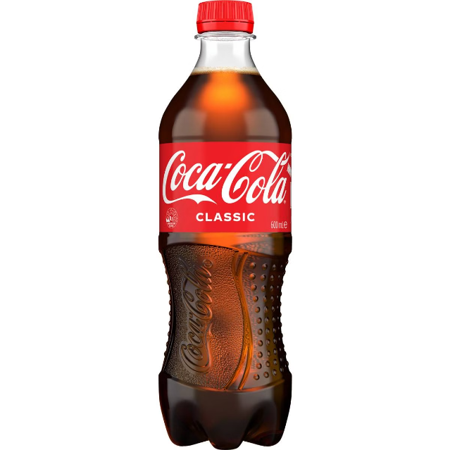
Coca-Cola: A Global Icon
Introduction :
Coca-Cola, starting as a simple carbonated soft drink in 1886, has evolved into one of the world's most iconic and recognizable brands. Today, it spans over 200 countries with a diverse product lineup extending well beyond its original cola..
Presented By :
1. Priyanka Shukla 4. Sanika Machutre
2. Roshani Gupta 5. Pushpa Khochare
3. Dipali Shinde

Slide 2
Product Portfolio
Flagship Products
Diversification
Innovations
Coca-Cola's flagship products, including Coca-Cola, Diet Coke, and Coke Zero, continue to be the backbone of the company's sales and revenue.
The company now offers many types of drinks like juices, teas, water, and energy drinks to meet the different tastes and preference of people around the world.
Coca-Cola regularly creates new flavors and versions of its classic drinks to stay current with what consumers like.

Slide 3

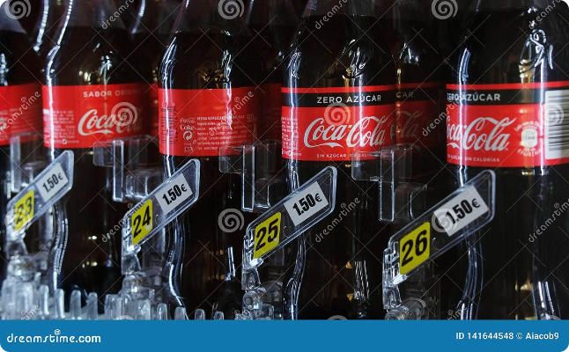
Price
1
Affordability
Coca-Cola's pricing strategy is designed to make its products accessible to a wide range of consumers, with a focus on providing value and affordability.
2
Premium Offerings
The company has also introduced premium-priced products, such as Coca-Cola Signature Mixers, to cater to the needs of more affluent consumers.
3
Dynamic Pricing
Coca-Cola's pricing is flexible, with the company adjusting prices based on factors such as location, competition, and market conditions.

Slide 4
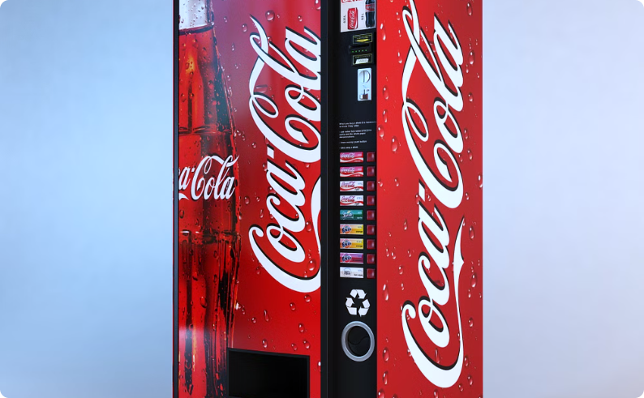
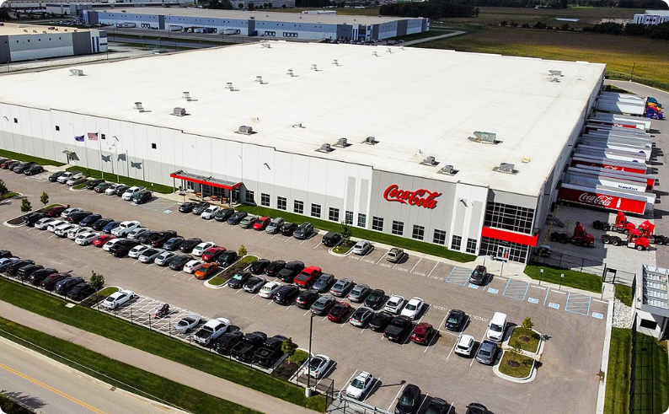
Place
Global Availability
Efficient Distribution
Coca-Cola products are found everywhere from grocery and convenience stores to restaurants and vending machines, ensuring they're available worldwide..
The company's widespread and effective distribution network ensures that its products reach consumers worldwide quickly and affordably.

Slide 5




Promotion
Digital Presence
Iconic Advertising
Sponsorships
Coca-Cola is active online, using social media and websites to connect with people and promote its brand.
That's a simplified version of the original sentence. If you have any other sentences or need further simplification, feel free to ask!
Coca-Cola's sponsorship of major events and sports competitions helps it become more visible and closely linked with popular culture.

Slide 6
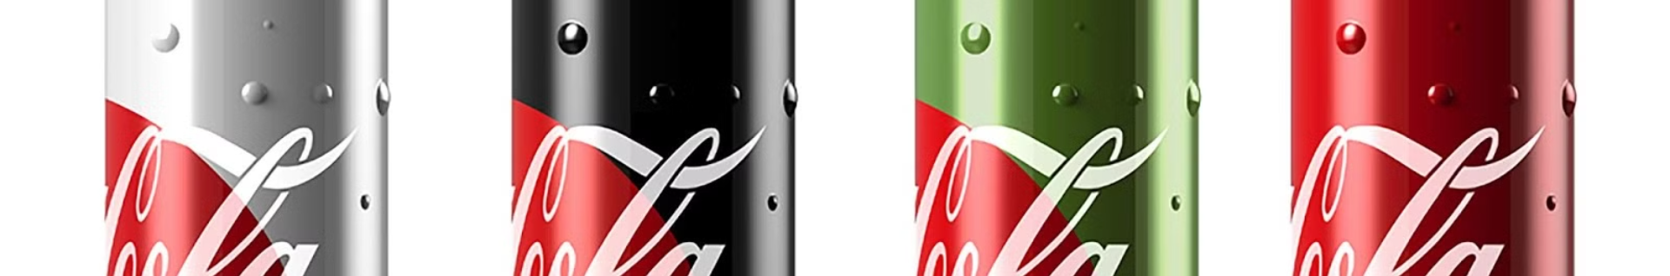



Pace and Packaging
Rapid Innovation
Sustainable Packaging
Convenient Packaging
Coca-Cola is known for its ability to quickly adapt to changing consumer preferences and market trends, introducing new products and packaging options at a rapid pace.
The company has also made strides in sustainability, introducing more environmentally-friendly packaging options and working to reduce its environmental impact.
Coca-Cola offers different packaging sizes (small cans to big bottles) to suit different customer needs and preferences worldwide.

Slide 7

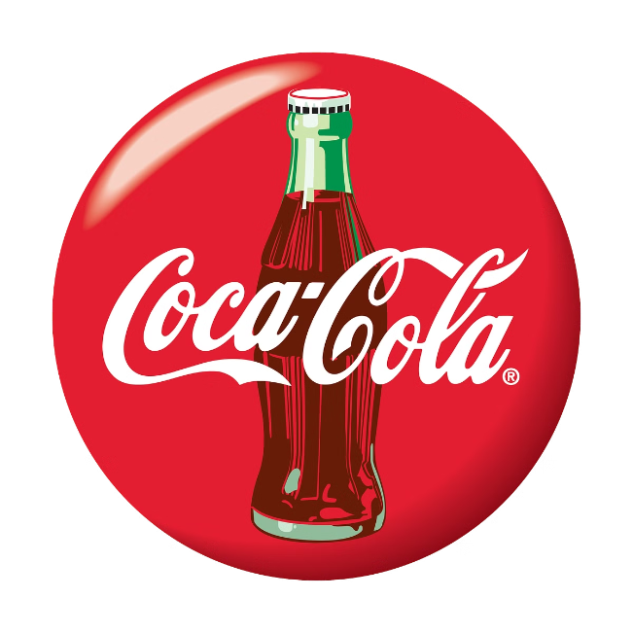
Position
Brand Equity
Coca-Cola is well-known for its unique taste and is recognized everywhere because of
its famous red and white logo.
Market Leadership
Coca-Cola's success with soda has made it a leader in the world's drink market.
Emotional Connection
Coca-Cola has cultivated a strong emotional connection with consumers, associating its brand with happiness, refreshment, and shared experiences.

Slide 8

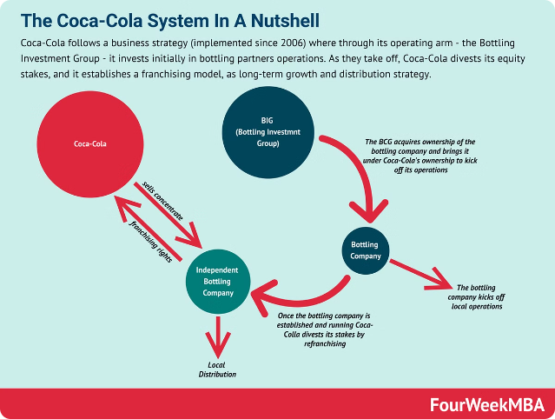
Objective
Objective
Increase global market share and expand into new beverage categories
Strategy
Coca-Cola continues to innovate, expand its range of products, and strengthen its brand.
Challenges
More people are focusing on health, other drink brands are competing, and there are worries about the environment.

Slide 9
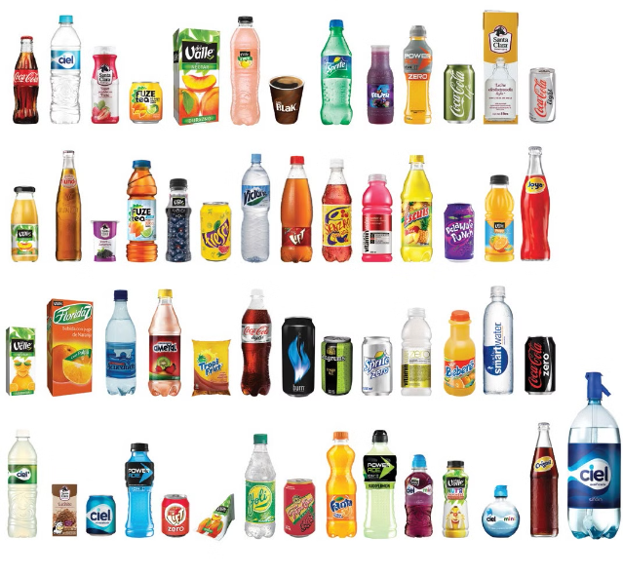
Conclusion
Coca-Cola's global success stems from its ability to adapt to market changes, innovate consistently, and maintain a steadfast commitment to delivering high-quality products. As it navigates the evolving beverage industry, Coca-Cola is well-positioned to uphold its market leadership and strengthen its status as a beloved global brand.

Slide 10
THANK YOU !

